Slide 1


CS 5513: Database Management Systems
Spring 2025
YouTube LINK: https://youtu.be/qkb4Cxp3FAg?feature=shared
Extending MySQL with Modern Caching Strategies: A Comparative Analysis of LIRS, TinyLFU, and S3-FIFO for Query Performance Optimization
PRESENTED BY GROUP-9
SASANK SRIBHASHYAM, VENKAT TARUN ADDA, CHANDANA SREE KAMASANI
1

Slide 2

introduction
MySQL 8.0 removed its native query result cache due to scalability issues.
This removal left a gap in optimizing performance for repeated query workloads.
Our project introduces a modular caching framework attempting to integrate directly into MySQL.
We implemented three advanced caching strategies: LIRS, TinyLFU, and S3-FIFO.
The system aims to reduce query latency, improve hit rates, and support diverse workloads.
2

Slide 3

Motivation
Modern applications often execute the same queries repeatedly, especially in dashboards and APIs.
Without query-level caching, MySQL must fully reprocesses identical queries each time.
This leads to unnecessary CPU usage, increased I/O, and slower performance.
Developers are forced to manage caching externally, increasing complxexity and inconsistency.
We aim to reintroduce efficient, engine-level caching to simplify development and boost performance.
3

Slide 4

Problem with Native Query Cache
MySQL’s original Query Cache was globally invalidated by any table update.
01
This caused cache entries to be flushed even for unrelated queries.
02
It could not scale under high-concurrency environments due to coarse locking.
03
Frequent invalidations led to low cache effectiveness and inconsistent performance.
04
As a result, the Query Cache was deprecated and removed in version 8.0.
05
4

Slide 5

Objectives
We aim to design a modular, pluggable caching framework within MySQL.
01
The system must support interchangeable strategies like LIRS, TinyLFU, and S3-FIFO.
02
Caching should be integrated between query parsing and execution without violating ACID properties.
03
Each strategy must adhere to a unified interface for admission, eviction, and lookup.
04
Our design should enable flexible experimentation and minimal disruption to MySQL’s core.
05
5

Slide 6
Objectives
To implement LIRS, TinyLFU, and S3-FIFO as independent, tunable caching modules.
01
The system to include benchmarking tools using TPC-H and SysBench workloads.
02
We aim to evaluate performance gains in latency, hit rate, and memory usage.
03
Our solution must support multi-threaded execution and maintain thread safety.
04
The framework should be generalizable to future MySQL versions and other SQL engines.
05
6

Slide 7

Related Work
LIRS was proposed to overcome LRU’s weakness in tracking long-term reuse.
01
It uses reuse distance and dynamically maintains LIR and HIR blocks.
02
Prior LIRS applications focus on block-level caches, not query-level reuse.
03
TinyLFU emphasizes cache admission using probabilistic frequency tracking.
04
It has proven effective in web caches but not yet in SQL engines.
05
7

Slide 8
Related Work
S3-FIFO introduces a three-tier queue to manage cache entry lifecycles.
01
It performs well under bursty loads but lacks database system integration.
02
Prior MySQL cache work focused on static or application-layer caching.
03
These approaches lack adaptability, concurrency support, and metadata use.
04
Our system is the first to embed these algorithms into MySQL’s pipeline.
05
8

Slide 9

Proposed Work
We propose a caching framework placed between query parsing and execution.
01
The goal is to capture repeated query results without affecting ACID guarantees.
02
Our first step is query fingerprinting to normalize syntactically different queries.
03
Normalized queries are hashed into fingerprints used as cache keys.
04
This improves cache reuse across logically equivalent queries.
05
9

Slide 10
Proposed Work
We designed a pluggable architecture to support interchangeable cache strategies.
01
Each strategy implements core operations: lookup, admit, evict, and update.
02
LIRS uses reuse distance, TinyLFU applies frequency-based admission filtering.
03
S3-FIFO stages queries across three queues based on repeated access.
04
All strategies share a common API for easy evaluation and tuning.
05
10

Slide 11
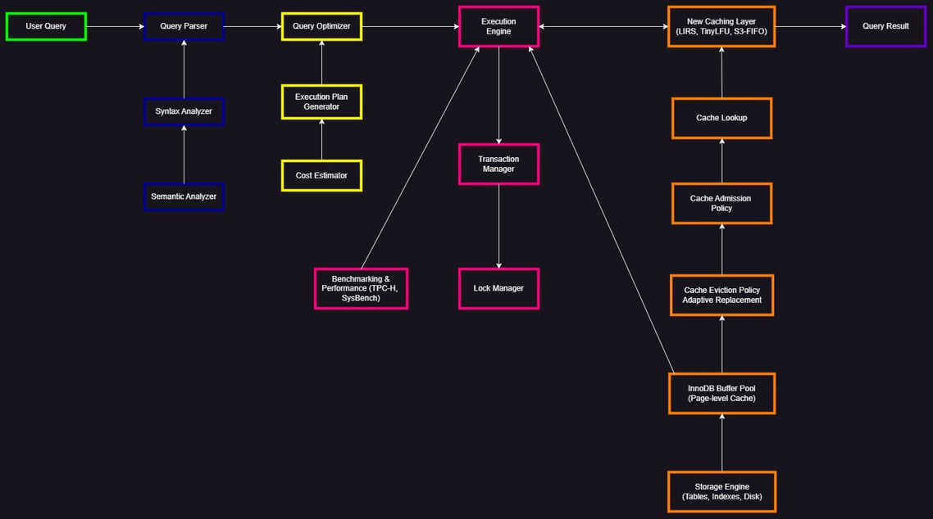
System Design – Query Flow and Parsing
User queries are parsed and validated for syntax and semantics.
01
The parser standardizes queries to a canonical form for fingerprinting.
02
Normalized queries enable detection of logical equivalence.
03
This ensures consistent cache lookup for repeated queries.
04
Only validated queries proceed to caching or execution stages.
05
11

Slide 12
System Design – Execution Engine and Transactions
The Execution Engine interprets optimized query plans for processing.
01
It coordinates with the Transaction Manager to ensure ACID compliance.
02
Lock management is enforced to handle concurrent query access safely.
03
Our cache integrates after optimization and before execution output.
04
A benchmarking module tracks cache performance metrics in real time.
05
12

Slide 13
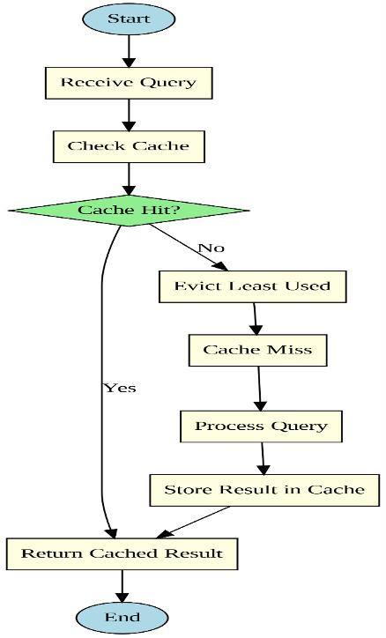
System Design – Caching Layer and Storage
The caching layer checks for a query fingerprint before execution.
01
On a cache miss, the result is computed and evaluated for admission.
02
Eviction policies vary by strategy: LIRS, TinyLFU, or S3-FIFO.
03
The cache complements InnoDB’s buffer pool without redundancy.
04
It enables both logical and physical multi-layer caching.
05
13

Slide 14
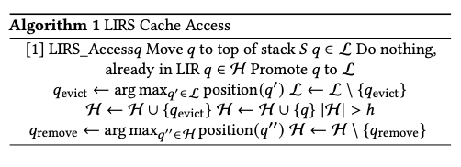
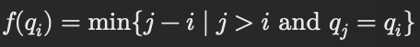
LIRS – Algorithm and Observation
LIRS uses reuse distance to distinguish frequently reused queries.
It maintains a recency stack (S) and partitions entries into LIR and HIR sets.
Queries are promoted or demoted based on inter-reference patterns.
This enables high cache hit rates under analytical workloads.
Equation:
14

Slide 15
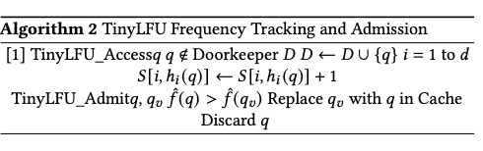
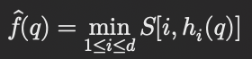
TINY FLU – Algorithm and Observation
TinyLFU filters queries using frequency estimation before cache admission.
It uses a Count-Min Sketch and a Doorkeeper Bloom filter.
Only high-frequency queries are allowed into the cache.
This strategy avoids pollution from one-time query results.
Equation:
15

Slide 16
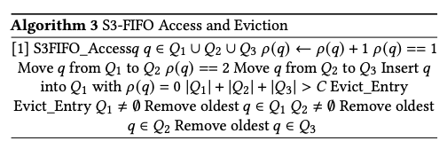
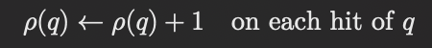
s3-FIFO – Algorithm and Observation
S3-FIFO divides cache into three FIFO queues: Q1, Q2, and Q3.
Queries are promoted through queues based on repeated access.
Eviction begins with Q1, then Q2, and finally Q3 as a last resort.
.
It balances performance and concurrency in dynamic workloads.
Equation:
16

Slide 17
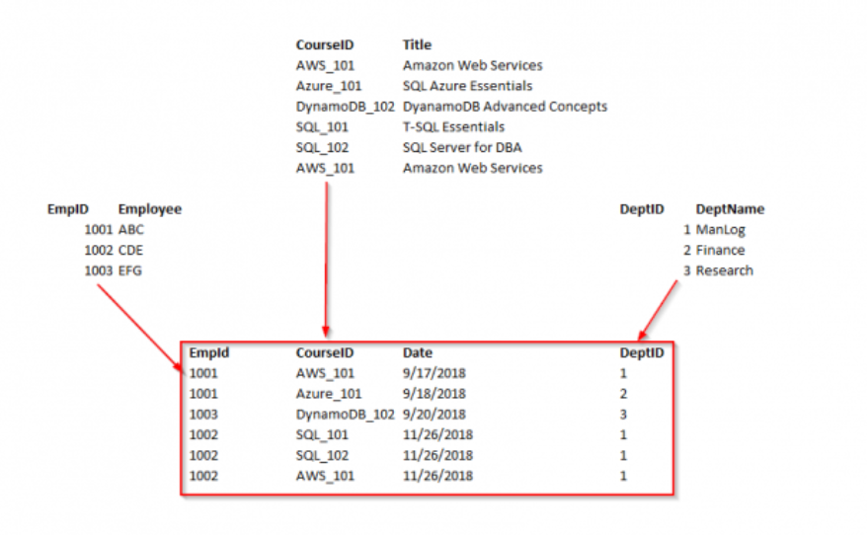
Experiment 1 – Query Normalization Validation
This experiment tested the consistency of query fingerprinting.
Syntactically different but logically equivalent queries were normalized.
Over 98% of equivalent queries mapped to identical fingerprints.
Logically distinct queries showed zero false collisions.
The normalization module effectively improved cache hit potential.
17

Slide 18
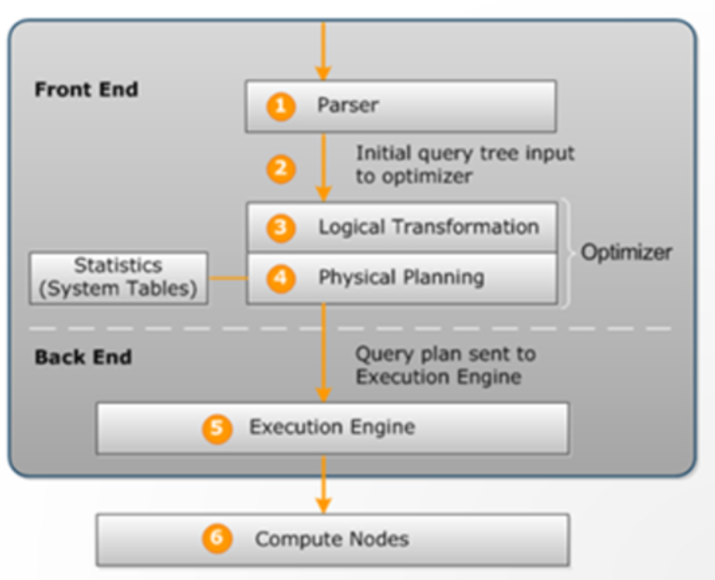
Experiment 2 – Cache Integration with Execution Engine
We validated the caching layer’s integration within MySQL’s execution path.
Queries were intercepted post-optimization for cache lookup.
Cache hits bypassed redundant computation and returned results instantly.
Under warm cache conditions, hit rates reached up to 100%.
The system maintained full transaction safety and thread correctness.
18

Slide 19
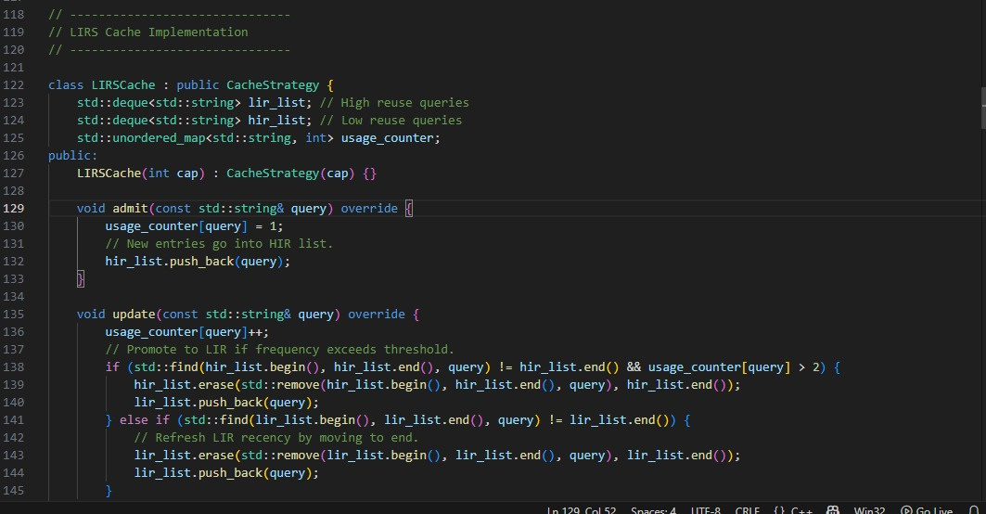
Experiment 3 – LIRS Strategy Evaluation
LIRS was evaluated on an analytics-style workload with repeated queries.
It maintained stable cache hit rates across varying memory conditions.
The LIR/HIR structure efficiently isolated one-time queries for eviction.
At medium cache size, LIRS achieved 85% hit rate—highest among strategies.
It adapted well to long-term reuse and temporal locality.
19

Slide 20
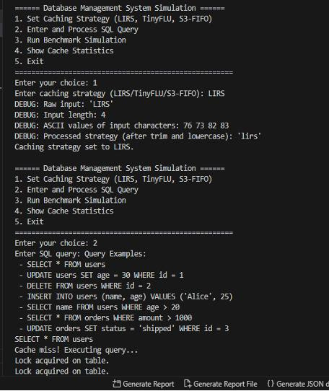
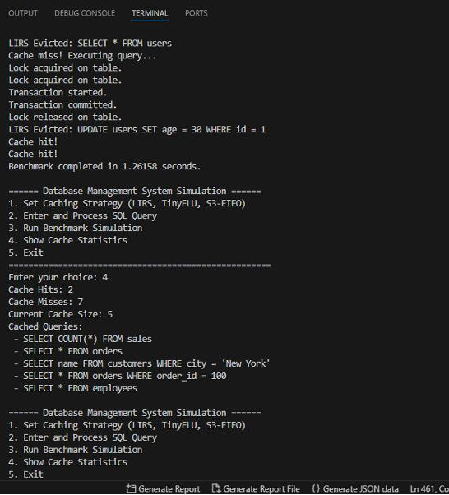
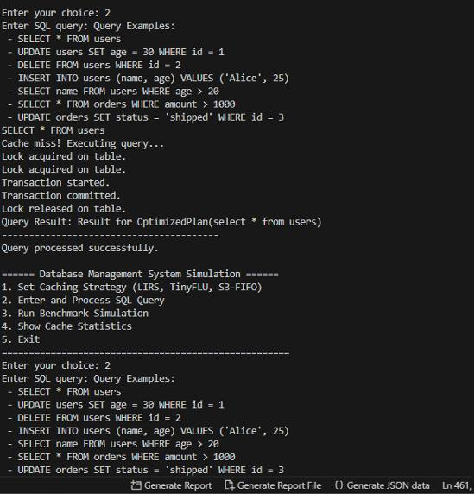
20

Slide 21
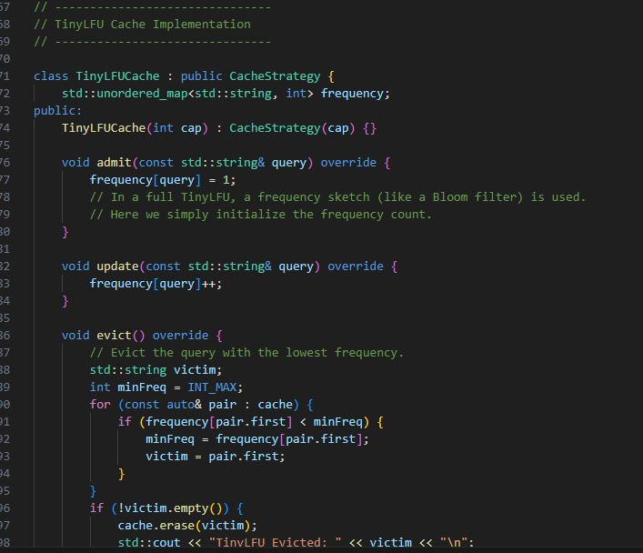
Experiment 4 – TinyLFU Strategy Evaluation
TinyLFU was tested with a Zipfian-distributed workload simulating access skew.
It filtered out over 70% of low-frequency, one-time queries.
High-frequency queries consistently passed the admission filter.
This led to a 15–20% improvement in cache hit rates over LRU.
TinyLFU used less than 2% of total cache memory for frequency tracking.
21

Slide 22
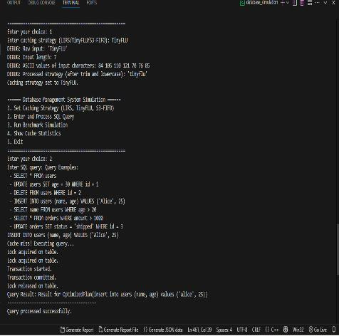
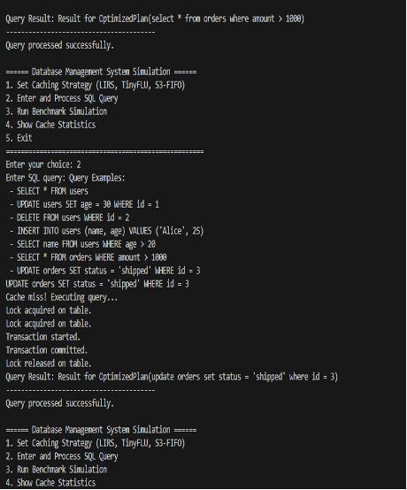
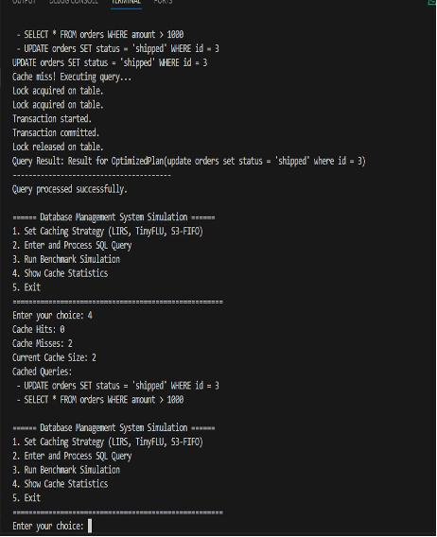
22

Slide 23
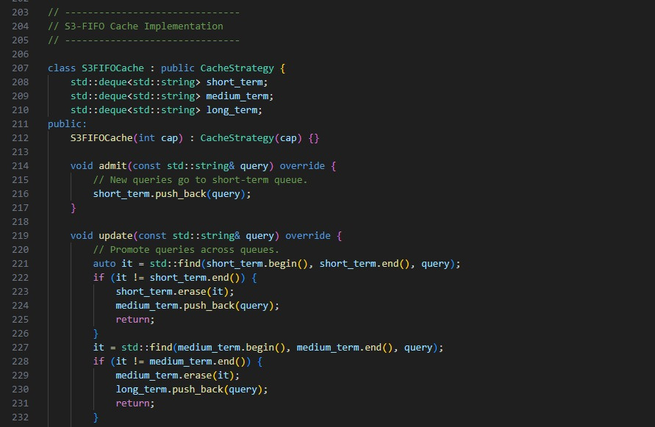
Experiment 5 – S3-FIFO Strategy Evaluation
S3-FIFO was tested under bursty, stable, and hybrid workload phases.
It used a three-queue system to promote valuable queries over time.
90% of one-time queries were filtered in the short-term queue (Q1).
Repeated queries progressed to long-term storage in Q3, improving reuse.
It reduced execution time variability by 28% compared to FIFO.
23

Slide 24
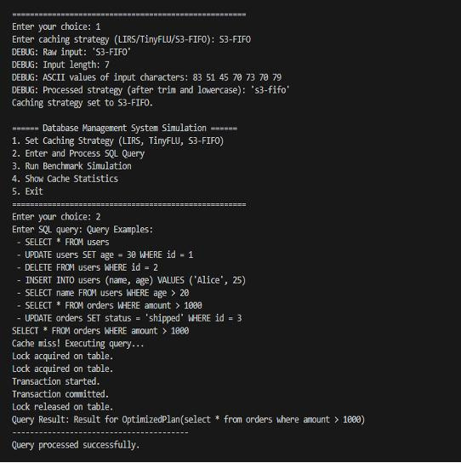
24

Slide 25
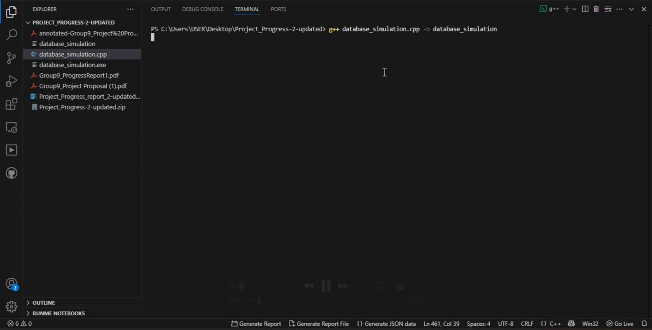
DEMO VIDEO
25

Slide 26
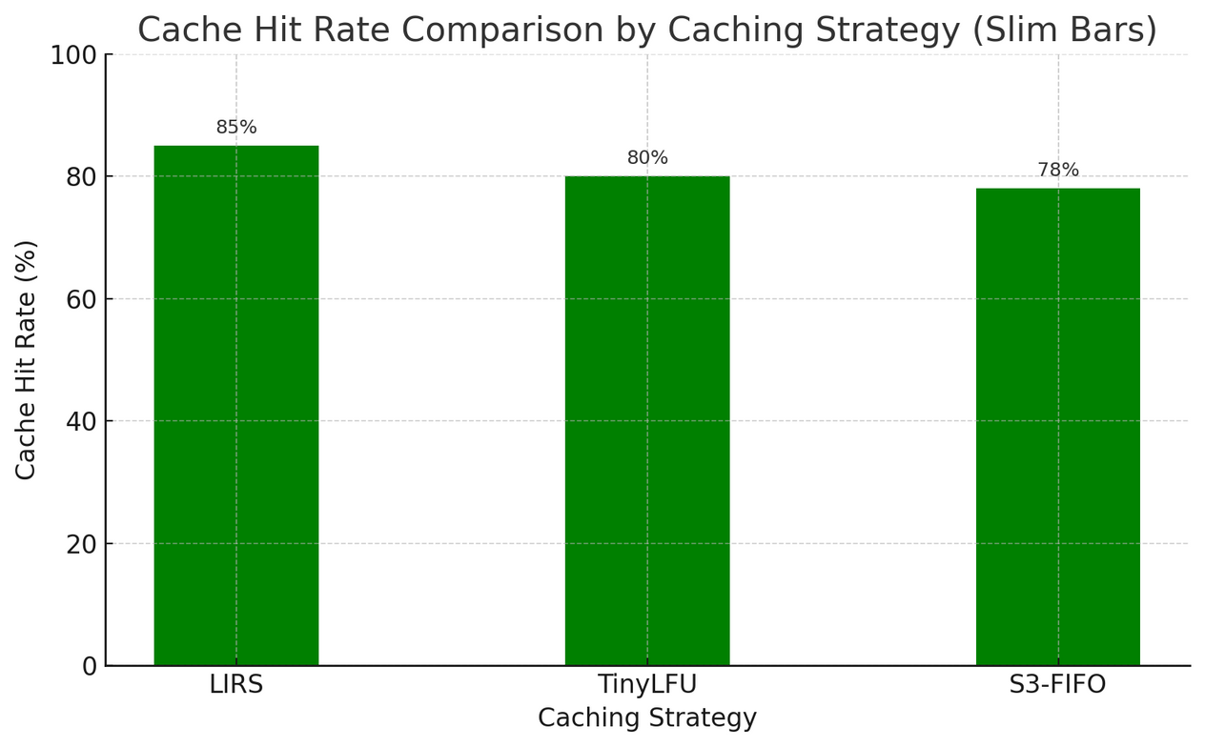
Results – Cache Hit Ratio Performance
LIRS achieved the highest cache hit ratio at 85% under read-heavy workloads.
TinyLFU also performed well by avoiding low-utility cache entries.
S3-FIFO balanced hit rate with concurrency in dynamic workloads.
All strategies outperformed the InnoDB Buffer Pool baseline by over 20%.
High hit rates confirmed effective reuse of normalized query results.
26

Slide 27
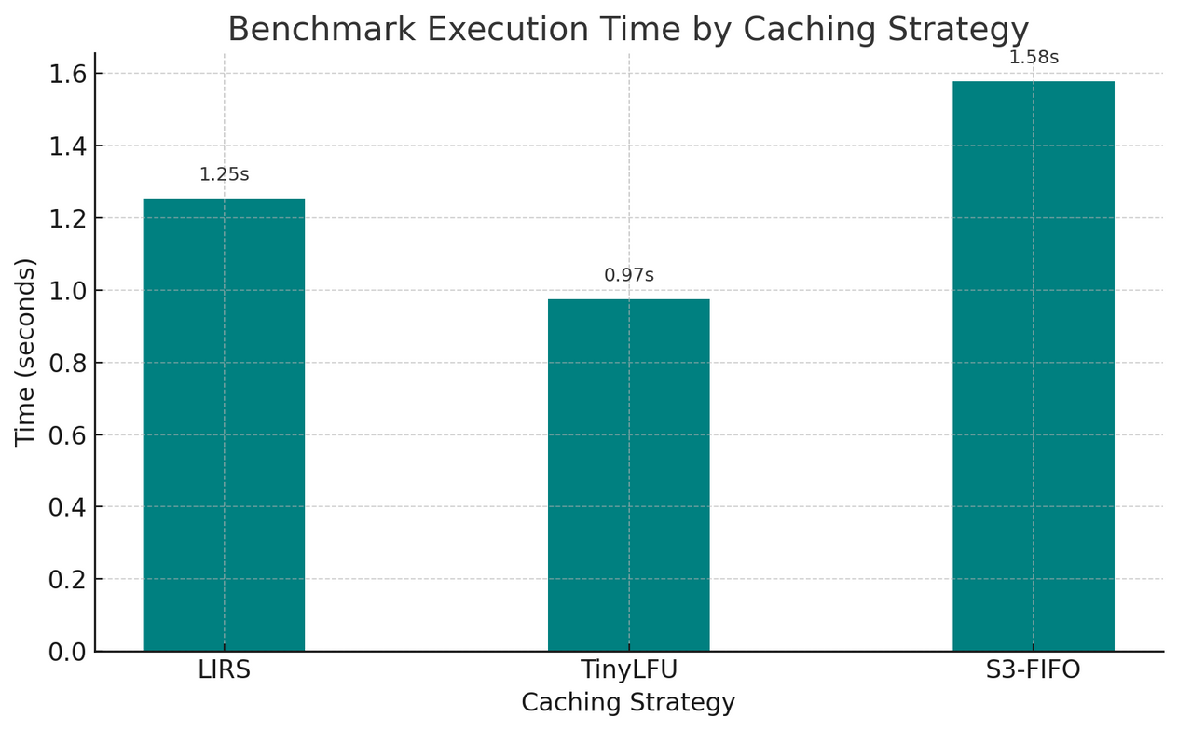
Results – Execution Time and Memory
Query execution times dropped by 25–30% in warm cache conditions.
TinyLFU and S3-FIFO showed minimal overhead during cache lookup.
LIRS maintained performance under memory-constrained environments.
TinyLFU used under 2% additional memory for frequency tracking.
The caching layer introduced negligible latency during query admission.
27

Slide 28
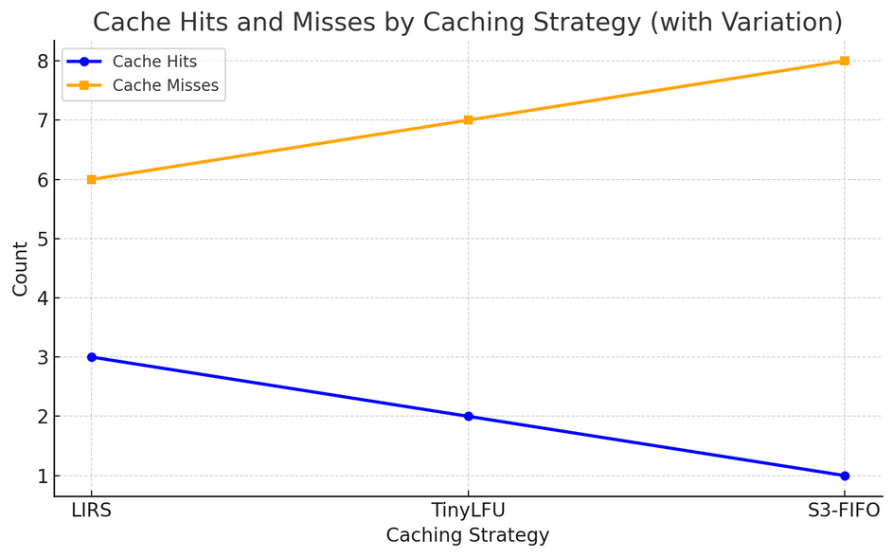
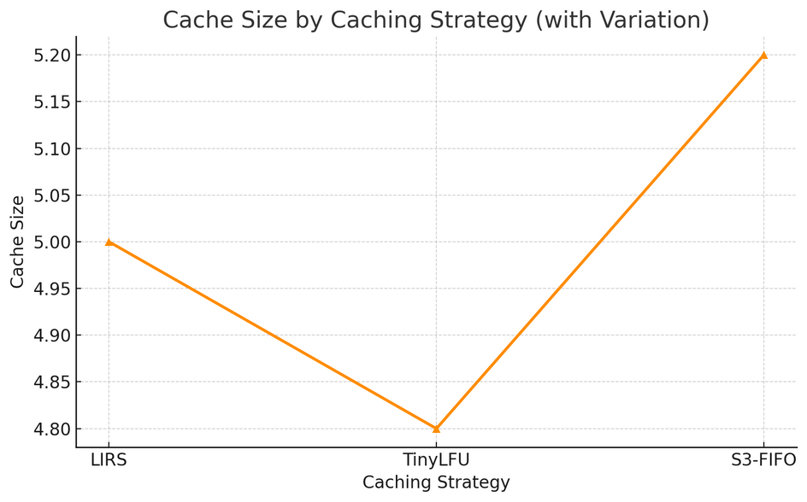
Results – Adaptability Across Workloads
LIRS excelled in analytical scenarios with repeated long-term queries.
TinyLFU handled mixed and bursty access patterns with high selectivity.
S3-FIFO performed best under high concurrency and transactional loads.
The system dynamically adapted to workload changes without reconfiguration.
Each strategy demonstrated clear strengths depending on workload type.
28

Slide 29

Conclusion
We successfully reintroduced query result caching into MySQL 8.0.
Our framework integrates LIRS, TinyLFU, and S3-FIFO as modular strategies.
All caching strategies significantly improved hit rates and reduced latency.
The system maintained full ACID compliance and thread safety throughout.
This work proves that intelligent caching is both feasible and beneficial in modern SQL engines.
29

Slide 30

Future work
We plan to explore hybrid caching strategies combining LIRS, TinyLFU, and S3-FIFO.
Machine learning could guide adaptive cache admission and eviction decisions.
Support for multi-layer caching with disk-based spillover is under consideration.
We aim to extend this framework to other databases like PostgreSQL.
Future benchmarks will include real-world applications and cloud-native workloads.
30

Slide 31
References
01
Jiang, S., & Zhang, X. (2002). LIRS: An Efficient Low Inter-reference Recency Set Replacement Policy. ACM SIGMETRICS.
Granbohm, C., & Nordin, A. (2019). Dynamic Caching for App-Side Caching. ACM SoCC.
06
Einziger, G., et al. (2015). TinyLFU: A Highly Efficient Cache Admission Policy. ACM TOS, 11(4), 1–31.
02
MySQL Documentation Team. MySQL 5.7 Reference Manual – Query Cache. Oracle, 2013–2023.
07
03
Yang, C., Li, Z., & Sun, W. (2023). S3-FIFO: A Three-Static-Queue FIFO Cache Algorithm. IEEE Trans. on Computers.
MySQL Documentation Team. MySQL 8.4 Reference Manual – Buffering and Caching. Oracle, 2013–2025.
08
Sinaga, M. R. S., & Sibarani, M. (2016). Caching Database to Reduce Query Response Time. IJCA, 975, 8887.
04
Ren, Q., Dunham, M. H., & Kumar, V. (2003). Semantic Caching and Query Processing. IEEE TKDE, 15(1), 192–210.
09
05
Ni, L., Han, Y., & Wu, J. (2018). Optimization of Cache Extension in MySQL. JDBSA, 24(3), 113–127.
Hellerstein, J. M., & Naughton, J. F. (1996). Query Execution Techniques for Caching Expensive Methods. ACM SIGMOD, 423–434.
10
31

Slide 32

32

